Slide 1
LISA Short Course Series R Statistical Analysis
Ning Wang
Summer 2013
LISA: R Statistical Analysis
Summer 2013

Slide 2




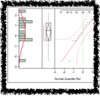
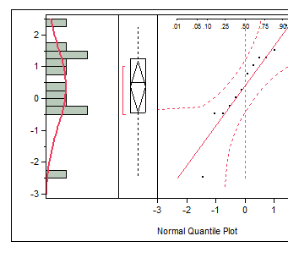

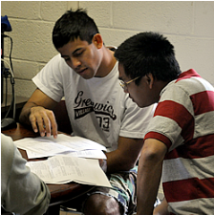


Laboratory for Interdisciplinary Statistical Analysis
LISA helps VT researchers benefit from the use of Statistics
Collaboration:
Visit our website to request personalized statistical advice and assistance with:
Experimental Design • Data Analysis • Interpreting Results Grant Proposals • Software (R, SAS, JMP, SPSS...)
LISA statistical collaborators aim to explain concepts in ways useful for your research.
Great advice right now: Meet with LISA before collecting your data.
LISA also offers:
Educational Short Courses: Designed to help graduate students apply statistics in their research
Walk-In Consulting: M-F 1-3 PM GLC Video Conference Room for questions requiring <30 mins
All services are FREE for VT researchers. We assist with research—not class projects or homework.
www.lisa.stat.vt.edu

Slide 3
Outline
Review on plots
T-test
2.1 One sample t-test
2.2 Two sample t-test
2.3 Paired T-test
2.4 Normality Assumption & Nonparametric test
ANOVA
3.1 One-way ANOVA
3.2 Two-way ANOVA
Regression
LISA: R Statistical Analysis
Summer 2013

Slide 4
Review on plots
What do we actually do with a data set when it’s handed to us?
Using visual tools is a critical first step when analyzing data and it can often be sufficient in its own right!
By observing visual summaries of the data, we can:
Determine the general pattern of data
Identify outliers
Check whether the data follow some theoretical distribution
Make quick comparisons between groups of data
LISA: R Statistical Analysis
Summer 2013
LISA: R Basics
Summer 2013

Slide 5
Review on plots
plot(x, y) (or equivalent plot(y~x)) scatter plot of variables x and y
pairs(cbind(x, y, z)): scatter plots matrix of variables x, y and z
hist(y): histogram
boxplot(y): boxplot
lm(y~x): fit a straight line between variable x and y
LISA: R Statistical Analysis
Summer 2013

Slide 6
T-TEST
2.1 One sample t-test
Research Question:
Is the mean of a population different from the null hypothesis (a nominal value)?
Example:
Testing whether the average mpg (Miles/(US) gallon)of cars is different from 23 mpg
Hypothesis:
Null hypothesis: the average mpg of cars is 23 mpg
Alternative hypothesis: the average mpg of cars is not equal to(or greater/less than) 23 mpg
In R: t.test(x, y = NULL, alternative = c("two.sided", "less", "greater"), mu = 0, paired = FALSE, var.equal = FALSE, conf.level = 0.95)
LISA: R Statistical Analysis
Summer 2013

Slide 7
T-Test
2.2 Two sample t-test
Research Question: Are the means of two populations different?
Example:
Consider whether the average mpg of automatic cars is different from manual?
Hypothesis:
Null hypothesis: the average mpg of automatic cars equals to the average mpg of manual cars
Alternative hypothesis: the average mpg of automatic cars is not equal to (or greater/less than) the average mpg of manual cars
In R: t.test(mpg~am)
t.test(mpg~am,var.equal=T)
LISA: R Statistical Analysis
Summer 2013

Slide 8
T-TEST
2.3 Sample size calculation
Research Question:
How many observations are needed for a given power or What is the power of the test given a sample size?
Power = probability rejecting null when null is false
In R: power.t.test(n = NULL, delta = NULL, sd = 1, sig.level = 0.05, power = NULL, type = c("two.sample", "one.sample", "paired"), alternative = c("two.sided", "one.sided"), strict = FALSE)
Calculate power given a sample size: power.t.test(delta=2,sd=2,power=.8)
Calculate the sample size given a power: power.t.test(n=20, delta=2, sd=2)
LISA: R Statistical Analysis
Summer 2013

Slide 9
T-TEST
2.4 Paired T-test
Research Question:
Given the paired structure of the data are the means of two sets of observations significantly different?
Example: a study was conducted to generate electricity from wave power at sea. Two different procedures were tested for a variety of wave types with one of each type tested on every wave. The question of interest is whether bending stress differs for the two mooring methods.
In R: t.test(method1,method2,paired=T)
or : t.test(diff), diff=method1-method2
LISA: R Statistical Analysis
Summer 2013

Slide 10
T-TEST
2.5 Checking assumptions & Nonparametric test
Using t-test, we assume the data follows a normal distribution, to check this normal assumption: visualization and statistical test.
Visualization
Histogram: shape of normal distribution: symetric, bell-shape with rapidly dying tails.
QQ-plot: plot the theoretical quintiles of the normal distribution and the quintiles of the data, straight line shows assumption hold.
Statistical Test: Shapiro-Wilk Normality Test
In R: shapiro.test(data)
LISA: R Statistical Analysis
Summer 2013

Slide 11
T-TEST
2.5 Checking assumptions & Nonparametric test
When the normal assumption does not hold, we use the alternative nonparametric test.
Wilcoxon Signed Rank Test
Null hypothesis: mean difference between the pairs is zero
Alternative hypothesis: mean difference is not zero
In R: wilcox.test(x, y = NULL, alternative = c("two.sided", "less", "greater"), mu = 0, paired = FALSE, exact = NULL, correct = TRUE, conf.int = FALSE, conf.level = 0.95, ...)
LISA: R Statistical Analysis
Summer 2013

Slide 12
ANOVA--Analysis Of Variance
T-test: Compare the mean of a population to a nominal value
or compare the means of equivalence for two populations
How about compare the means of more than two populations?
We use ANOVA!
One-Way ANOVA: Compare the means of populations where the variation are attributed to the different levels of one factor.
Two-Way ANOVA: Compare the means of populations where the variation are attributed to the different levels of two factors.
LISA: R Statistical Analysis
Summer 2013

Slide 13
ANOVA--Analysis Of Variance
One-way ANOVA
Example: Compare the mpg for 3 cyl levels
mtcars data: mpg: Miles/(US) gallon
cyl: Number of cylinders
am: Transmission (0 = automatic, 1 = manual)
Hypothesis:
Null hypothesis: null hypothesis the three levels have equal mpg
Alternative hypothesis: at least two levels do not have equal mpg
In R: aov(mpg~factor(cyl)) and summary(a.1)
LISA: R Statistical Analysis
Summer 2013

Slide 14
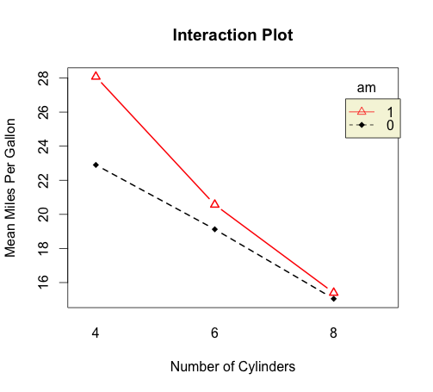
ANOVA--Analysis Of Variance
2. Two-way ANOVA
Example: Compare the mpg for 3 cyl levels and 2 types of transmission
Three effects to be considered: cyl levels, types of transmission and the interactions
In R: a.2 = aov(mpg~factor(am)*factor(cyl)) and summary(a.2)
LISA: R Statistical Analysis
Summer 2013

Slide 15
Regression
Research Question: What the relationship between two variables? Or one variable with several other variables?
Example: Brownlee's Stack Loss Plant Data
Air.Flow: Flow of cooling air
Water.Temp: Cooling Water Inlet Temperature
AcidConc.: Concentration of acid [per 1000, minus 500]
stack.loss: Stack loss
What is the relationship of Air.Flow and the stack.loss?
Or How are the variables Air.Flow, Water.Temp and Acid.Conc related to stack.loss?
In R: lm(formula, data, subset, weights, na.action, method = "qr", model = TRUE, x = FALSE, y = FALSE, qr = TRUE, singular.ok = TRUE, contrasts = NULL, offset, ...)
LISA: R Statistical Analysis
Summer 2013

Slide 16
Please don’t forget to fill the sign in sheet and to complete the survey that will be sent to you by email.
Thank you!
LISA: R Statistical Analysis
Summer 2013

